Slide 1
Cross Campus
By XCampus

Slide 2
XCampus is:
A team based Collaborative By:
Pavle Boraniev,
Kazuma Sato,
Mark Gallant
Dedicated to free, open collaborations for students everywhere
Passionate about making student interactions easy

Slide 3
Cross Campus is:
A multi-platform REST styled API service, supplied by a relational database
An education based listing service (Tutoring, Study Groups, Textbooks)
User powered note repository, sorted institutionally, by program and more..
Content based commenting
User experience and rating system
A base of real, registered users who can offer advice to each other and easily interact without worry of being “called out”

Slide 4
Cross Campus is not:
A walled garden
A social media platform
A dedicated forum
A piracy den

Slide 5
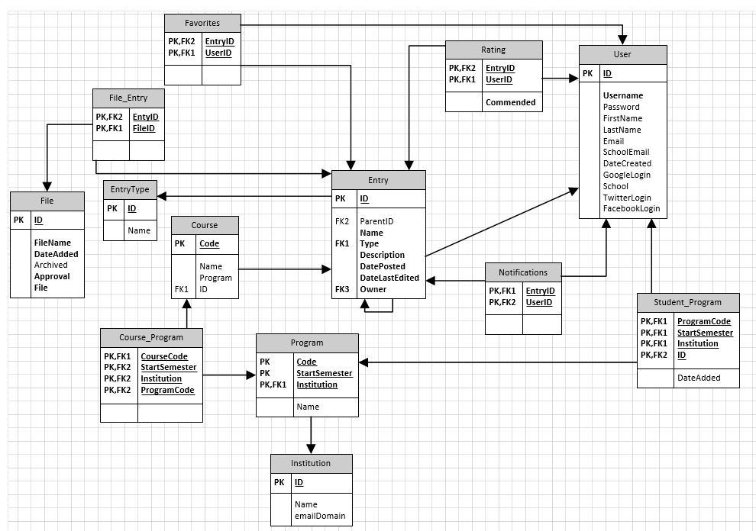
Take a Backend Look:
Our relational tables

Slide 6
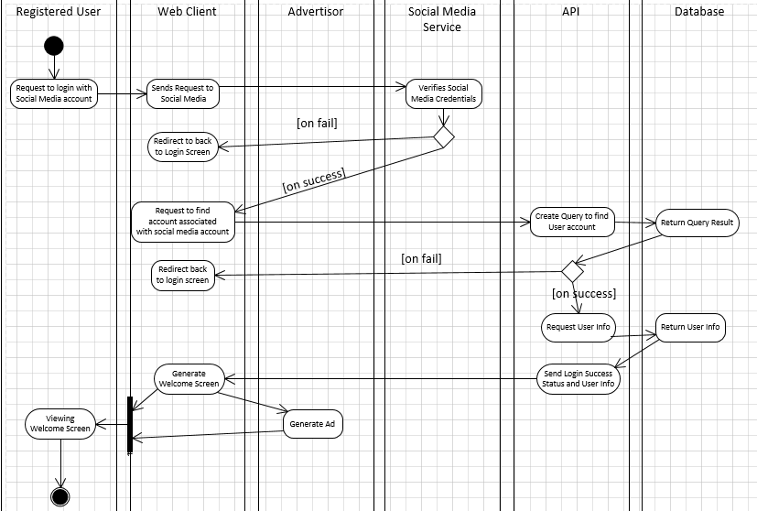
Take a Backend Look:
Making an account with social media login

Slide 7
What we support
Website
Android application
What we Could support***
IOS
Desktop Apps
***people power required!

Slide 8
Class Diagram
Our Web Classes:
Our Android Classes:

Slide 9
Our Design
Web Wireframe:
Mobile Wireframe:

Slide 10
And Beyond:
CROSS CAMPUS COLLABORATIVE LEARNING ENVIRONMENT

Slide 11
Thank You For Staying

